Slide 1
An Analysis of Two ETFs
Jay Noppone P, Abdul Andha, Olu Kukoyi, Nur Mazumder, Mansij Mishra, Tajwar Rahman

Slide 2






The Team
Abdul Andha
Olu Kukoyi
Nur Mazumder
Jay Noppone P
Tajwar Rahman
Mansij Mishra

Slide 3
Agenda
01
04
02
05
03
06
Intro & Problem Statement
Data Extraction
Pitch
Business Intelligence
Method and Process
Application Stack

Slide 4
INTRODUCTION AND PROBLEM STATEMENT

Slide 5
Introduction and Problem
Problem Statement and Context
Questions we want to address
People have difficulty choosing between different ETFs as there are many factors to consider including holdings, sector weights, fees, risk, volatility, etc
The A-B product comparison is interesting because it allows users to quantify and visualize differences between similar ETFs
What are the key factors that differentiate two ETFs?
Which performance metrics best capture the suitability of a given ETF for a user?
How can we account for external economic factors that may impact an ETF’s performance?

Slide 6
Pitch

Slide 7
Pitch #1 - Solution
GOAL: Create a Visual Comparison Tool
This tool will give users the ability to compare metrics across different stocks and ETFs using visualizations to help them reach informed conclusions
It will provide intuitive visualizations (charts, graphs, and tables) to compare key metrics across stocks and ETFs.
Highlight metrics such as historical performance …..
Provide personalized recommendations based on user preferences and investment goals.
Primary Stakeholders:
The primary stakeholders are people that have money to invest into the market but don’t have the time to do thorough research

Slide 8
Pitch #2 - Benefits
Time Saving
Reduces the time spent on analyzing data and making comparisons across different investment options.
Enhances Decision Making
By comparing multiple stocks and ETFs, users can make better investment decisions.
Data visualization simplifies complex data, making it easier to understand trends and performance.
User Empowerment
Provides users with the tools they need to make confident investment decisions.
Educational Resource
Useful for teaching users how to evaluate investments effectively and understanding various metrics.

Slide 9
METHOD AND PROCESS

Slide 10
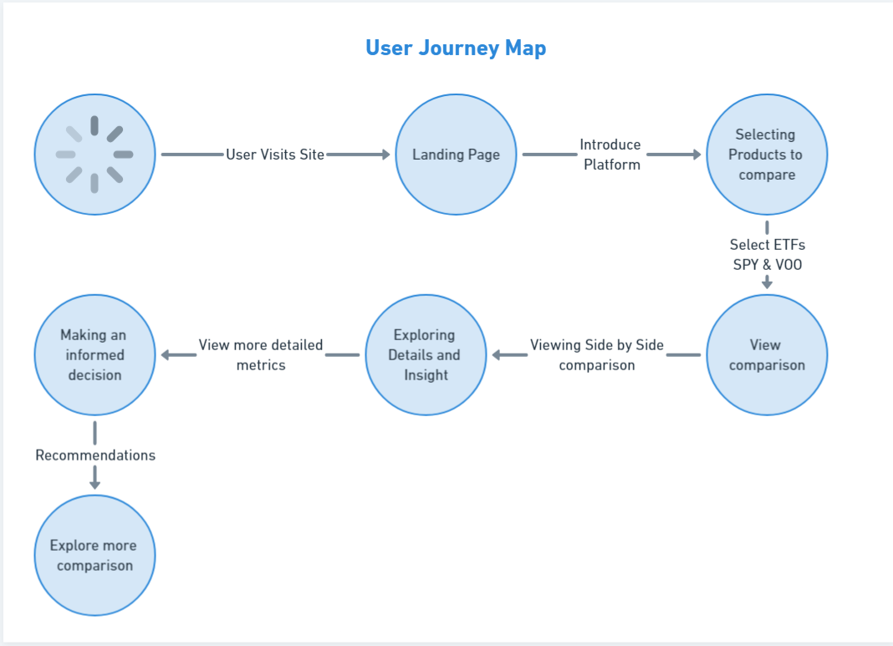
USER JOURNEY

Slide 11
METHODOLOGY
Executive Summary
Data collection methodology:
Alpha Vantage API, Yahoo Finance API (yfinance)
Kaggle for S&P 500 and Vanguard 500 Index Fund
Storage: PostgreSQL
Perform exploratory data analysis (EDA) using visualization
Create an interactive dashboard using Tableau for metric comparisons and performance visualizations
Visualization Features:
Time-series analysis for historical trends in SPY and VOO
Comparison Charts to easily visualize performance and risk profiles

Slide 12
DATA EXTRACTION

Slide 13
DATA COLLECTION
Retrieve historical VOO and SPY data from Kaggle datasets
Retrieve up-to-date information from yfinance API
Utilize the yf.Ticker() and ticker.history() methods to retrieve data from specific dates in history
Convert responses retrieved from API to DataFrames for data analysis
Clean data from NULL or MISSING values by replacing missing/null values
Overall goal: parse data desired and convert into Pandas DataFrame table

Slide 14
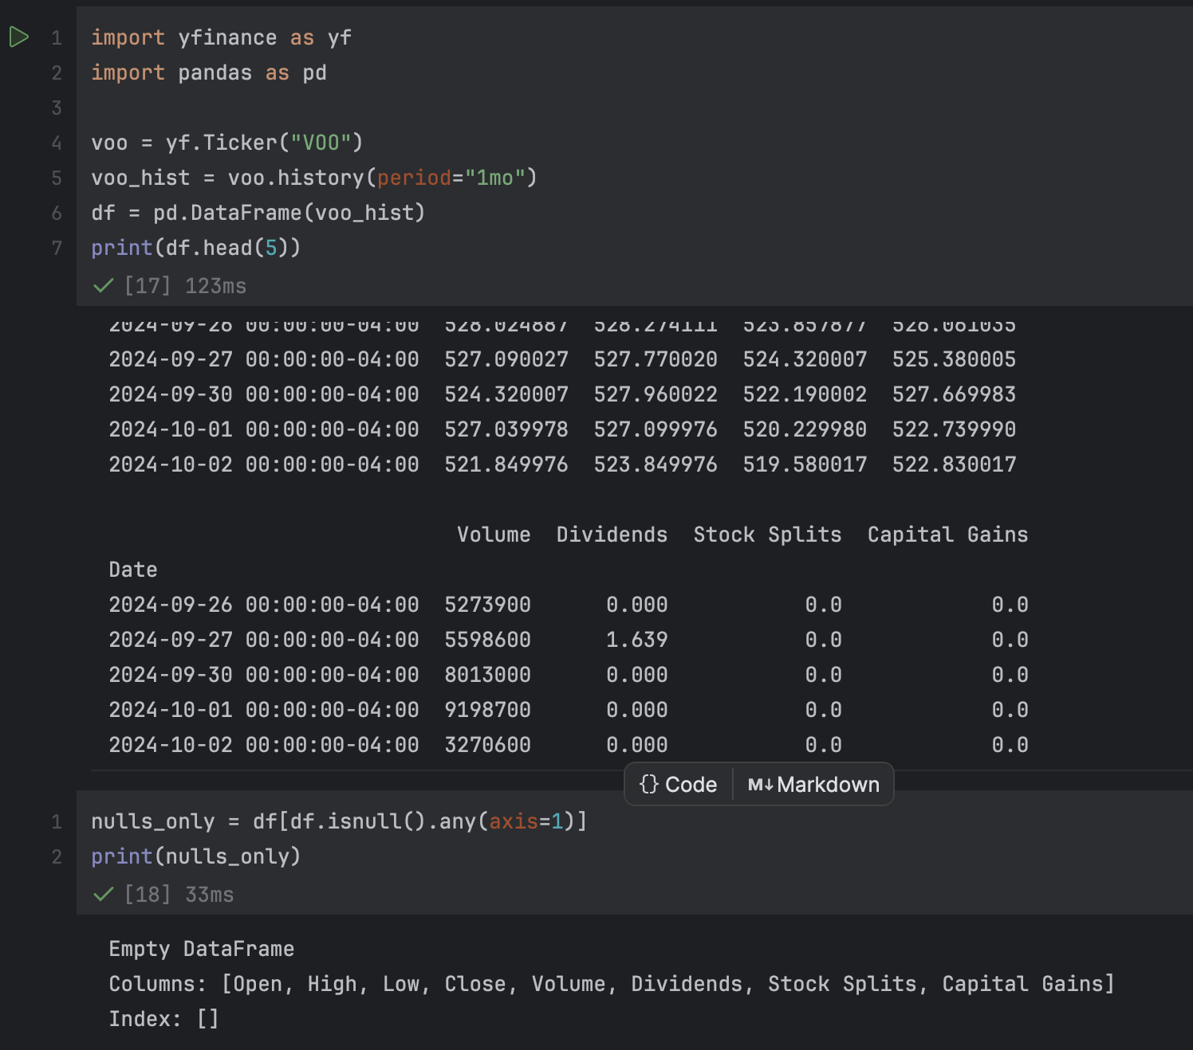
YAHOO FINANCE
With the yfinance API library, retrieve data on any stock index with the yf.Ticker() method
voo.history(period=period) retrieves specific data based on the last period (e.g. 1 month, 2 months, 3mo, etc.)
Converted API response to DataFrame and applied DF methods
Cleaned data of nulls (no nulls were found)

Slide 15
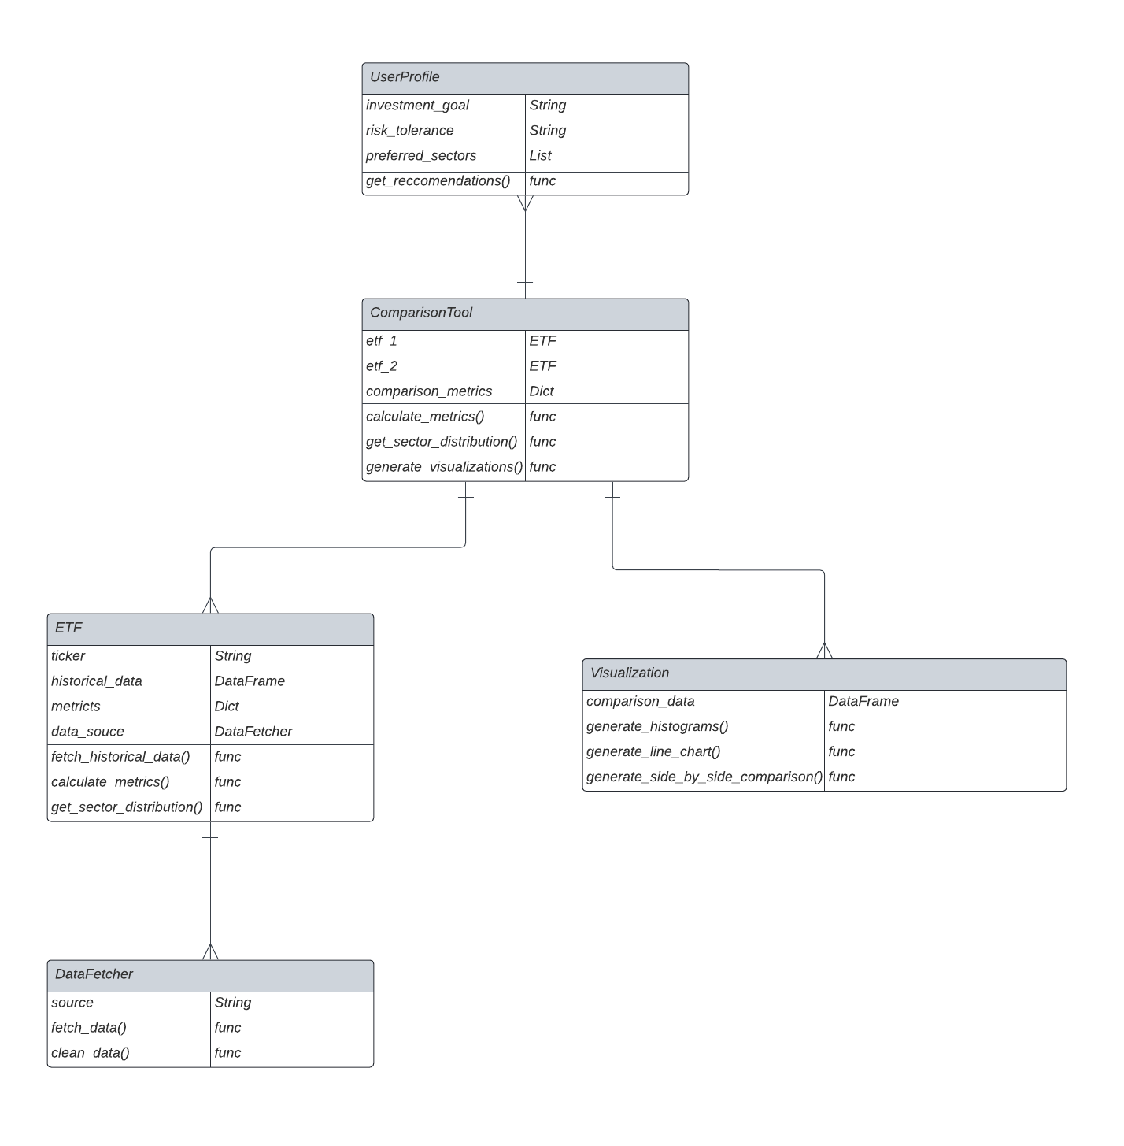
THE DATA MODEL

Slide 16
BUSINESS INTELLIGENCE

Slide 17
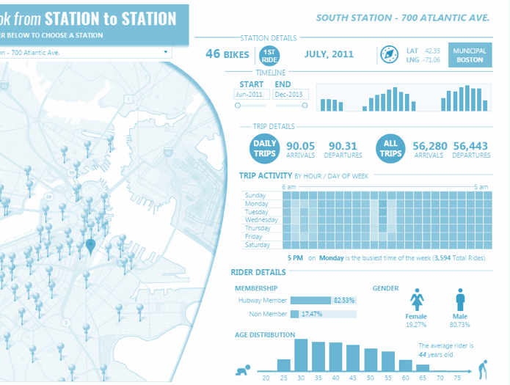
WHAT ARE THE METRICS/CHARTS
ETF Comparison
expense ratios, risk scores, etc.
Performance
Time series, heatmaps, etc.
Custom Views
ETF holdings, sector weights , etc.
Engagement Insights
popular metrics

Slide 18
APPLICATION STACK

Slide 19









Tech Stack
Frontend
Backend
Data
Pipeline
Data
Visualization
Data
Science Libraries

Slide 20




Team Roles
Backend
Engineers (x2)
Database
Engineer (x2)
Devops
Engineer (x1)
Full-Stack
Engineer (x1)
Olu
Jay
Tajwar
Nur
Abdul
Mansij

Slide 21
Q&A

